Slide 1
Manage Artifact Versioning, Security and Compliance

Slide 2

HELLO!
I am Eng Teong Cheah
Microsoft MVP
You can find me at @walkercet

Slide 3
Package Security
1

Slide 4
Package Feeds
Trusted source of packages
Secured for access by authorized accounts

Slide 5
Package compliance
Governmental
Certification
Standards Institute

Slide 6
Securing access to package feeds
Restricted access for consumption
Restricted access for publishing

Slide 7
Roles
Reader
Collaborator
Contributor
Stable parts
Owner

Slide 8
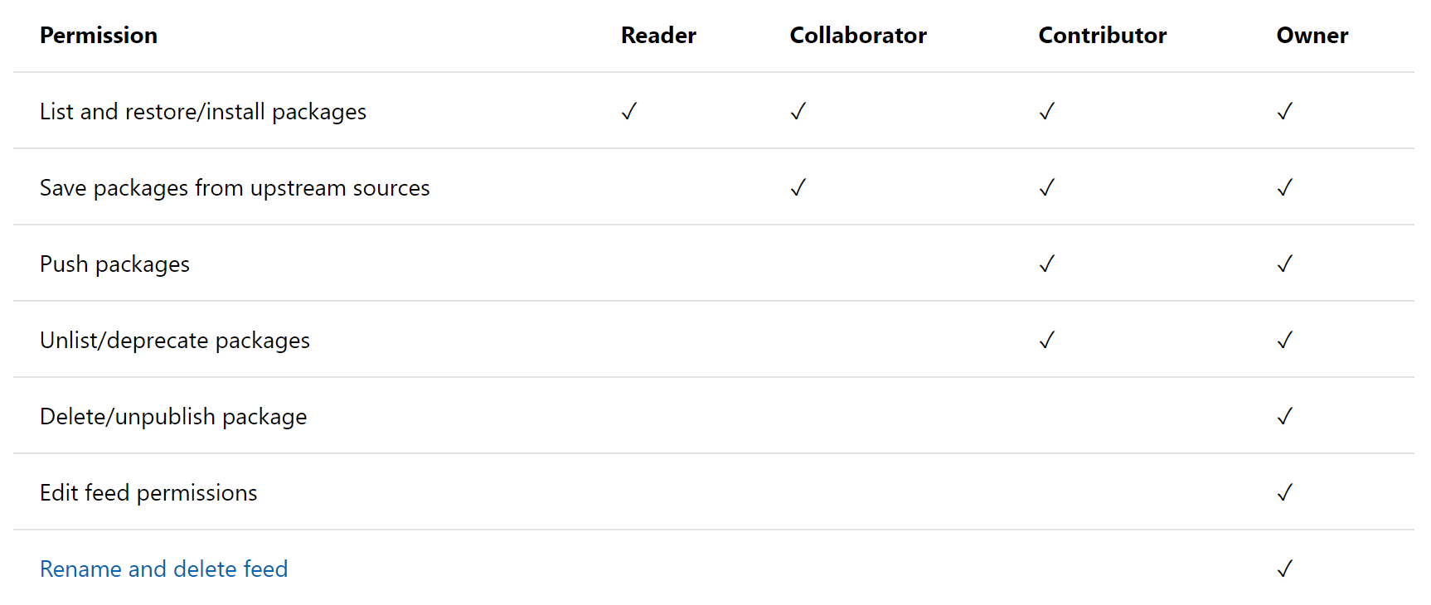
Permission

Slide 9
Credentials
Authentication is required for Azure Artifacts
Transparently taken care of when logged into portal or in build task
External package sources may required credentials

Slide 10
Open Source Software
2

Slide 11
Open-source Software
Open-source software (OSS) is a type of computer software in which source code is released under a license in which the copyright holder grants users the right to study, change, and distribute the software to anyone and for any purpose.

Slide 12
Challenge to corporates
Be of low quality
Have no active maintenance
Contain malicious code
Have security vulnerabilities
Have unfavourable licensing restrictions

Slide 13
Licenses and vulneabilities
Discriminate against persons or groups
Be specific to a product
Restrict other software

Slide 14
License implications and rating
Compliancy
Intellectual property
Exclusive rights

Slide 15
Demo
3
Manage Open Source Security and License with White Source

Slide 16
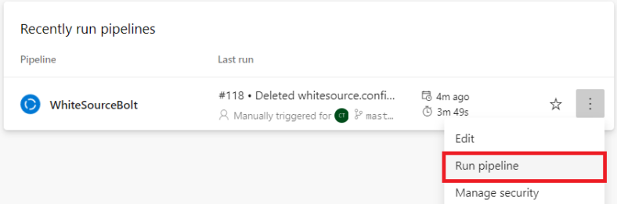
Go to Build section under Pipelines tab, select the build definition WhiteSourceBolt and click on Run pipeline to trigger a build.

Slide 17
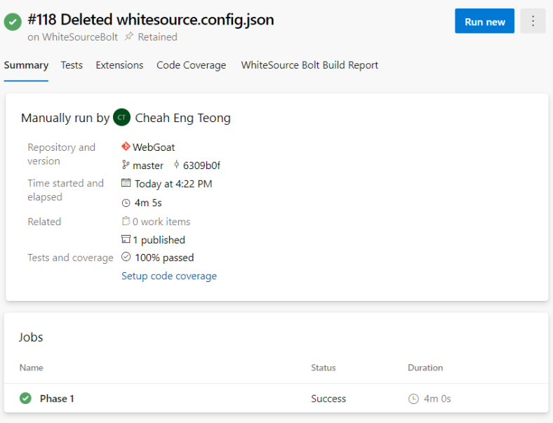
Once the build is completed, you will see the summary which shows Test etc. as show above.

Slide 18
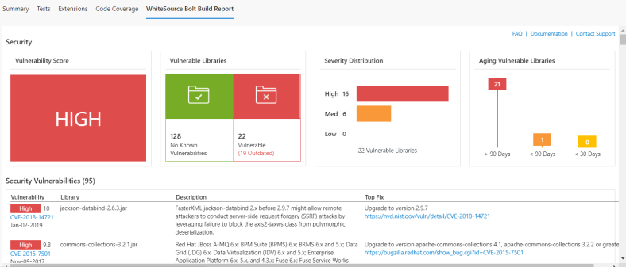
Navigate to White Source Bolt Build Report tab under Pipelines section and wait for the report generation of the completed build the vulnerability report.

Slide 19
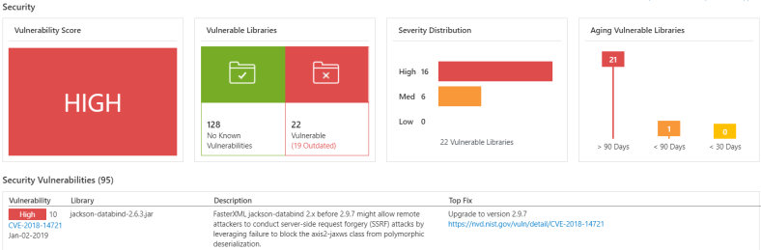
The security dashboard shows the vulnerability of the build. This report shows the list of all vulnerable open source components with Vulnerability Score, Vulnerable Librabries, Severity Distribution.

Slide 20
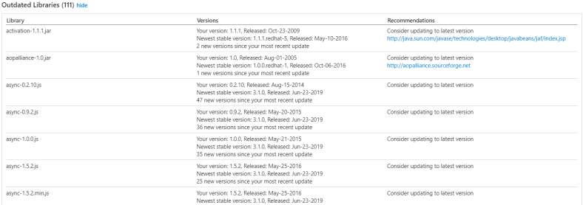
WhiteSource Bolt also tracks outdated libraries in the project, getting all the detailed information and links to newer versions and recommendations.

Slide 21
THANKS!
Any questions?
You can find me at
@walkercet

Slide 22
CREDITS
Microsoft Docs

